Slide 1

Design Patterns in Practice
A Cross-Language Paradigm Study
Implementing the Factory, Strategy, and Observer Patterns uniformly across Java, Kotlin, and Python ecosystems.
AUTHORS: ALBA GJERGJI, ANA GJERGJI, DION HASANBASHAJ
SYS.INIT // CORE_PARADIGMS
PAGE_01

Slide 2

System Architecture
THE TRAVEL AGENCY SIMULATOR BLUEPRINT
A highly focused environment built to isolate architectural layout mechanics from production ecosystem noise.
[DOMAIN_ENTITIES]
• Customer: Plain Data Holder
• Quotation: Creation Engine
The system models the exact execution block where a transient price quotation shifts directly into a validated, structurally sound, confirmed booking.
• Booking: Architecture Hub
To secure strict evaluation metrics, the architecture explicitly omits database engines, graphical user interfaces, and network drivers—routing every pattern transaction exclusively via console metrics.
SYS.LOG // DOMAIN_OVERVIEW
PAGE_02

Slide 3



The Convergence Hub
HOW THREE PATTERNS COOPERATE IN A SINGLE TARGET ENTITY
Rather than treating software design constructs as isolated concepts, the system unites all three patterns directly within the Booking class.
The Factory Target
The Strategy Context
The Event Subject
Booking objects are strictly produced via factory logic, safeguarding lifecycle parameters from loose direct creation instantiation.
Acts as the formal context block containing and running interchange evaluation rules without explicit class coupling.
Maintains abstract consumer logs, serving as the subject hub triggering decoupled system callbacks.
SYS.LOG // INTERSECTION_ANALYSIS
PAGE_03

Slide 4

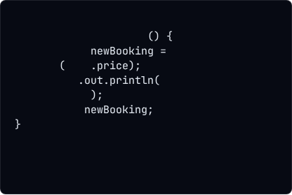
1. The Factory Pattern
CENTRALIZING OBJECT INSTANTIATION MECHANICS
The architecture delegates dedicated allocation responsibilities away from client actors, ensuring that object consumers never invoke structural constructors directly.
// Reference Java Implementation
public
Booking
accept
Booking
new
Booking
this
"[QUOTATION] Accepted..."
System
Quotation as the Creator
return
The Quotation entity operates as the creational generator, utilizing its accept() routine to return configured, validated Booking contexts with a guaranteed baseline state.
SYS.LOG // PATTERN_FACTORY
PAGE_04

Slide 5

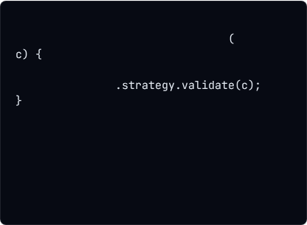
2. The Strategy Pattern
RUNTIME BEHAVIORAL INTERCHANGING
Enables alternative algorithm layers to swap at runtime by encapsulating verification variant processing engines behind an immutable abstract layer.
// Polymorphic Evaluation Logic
public
boolean
verifyEligibility
Customer
// Single interface execution trace
return
this
Decoupled Eligibility Contracts
EligibilityStrategy targets a standalone validation check interface. This allows concrete logic loops (AgeStrategy and PassportStrategy) to swap inside the booking pipeline without structural class rework.
SYS.LOG // PATTERN_STRATEGY
PAGE_05

Slide 6

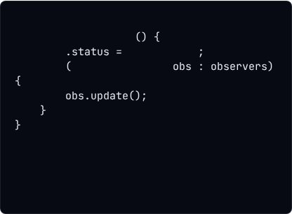
3. The Observer Pattern
DECOUPLED EVENT BROADCASTING MECHANICS
Establishes an asynchronous one-to-many event pipeline layout designed to broadcast state updates across detached handlers automatically.
// State Change Broadcast Block
public
void
confirm
this
"Confirmed"
for
BookingObserver
Dynamic Pipeline Execution
Once a booking shifts status codes to verified confirmation targets, it loops its inner registration stack, triggering update metrics across standalone handlers (LogObserver, EmailObserver).
SYS.LOG // PATTERN_OBSERVER
PAGE_06

Slide 7
Cross-Paradigm Engineering
IDENTICAL ARCHITECTURE ACROSS DISTINCT RUNTIMES
While Java serves as the foundational reference syntax, the code logic maps line-for-line into Kotlin and Python platforms. This guarantees identical operational layout results while utilizing distinct underlying compiler mechanics.
Structural Blueprint Element | Java Reference | Kotlin Hybrid | Python Dynamic
Role Abstraction | interface contract | Strict modern interface | Base Class with pass structures
Observer List Instantiation | ArrayList<> type allocation | Modern mutableListOf() hook | Built-in native array list handles
Strategy Method Processing | Direct pointer invocation | Null-Safe execution (?. check) | Guarded runtime conditional checks
SYS.LOG // STRUCTURAL_MATRIX
PAGE_07

Slide 8

Ecosystem Output Tracing
VALIDATING BYTE-FOR-BYTE COMPONENT CONSISTENCY
Testing confirms that all three translations process pipeline requests identically. The sample console trace documents each design pattern executing sequentially:
[QUOTATION]
<-- Factory Method Execution
[AGE CHECK]
<-- Interchangeable Strategy Validation
[BOOKING]
[LOG]
<-- Observer Notification Channel A
[EMAIL]
<-- Observer Notification Channel B
* System verification check: If an eligibility constraint processing trace fails, status assignment stays blocked and downstream notifications are automatically suppressed.
SYS.LOG // RUNTIME_TRACE
PAGE_08

Slide 9

Extension Capabilities
DEMONSTRATING TRUE ARCHITECTURAL FLEXIBILITY
The central value of this structural footprint lies in total conformance with the Open-Closed Principle (OCP).
[SCALING_MECHANISMS]
Add New Booking Subtypes via Factory Seams
The core codebase remains completely locked down against intrusive runtime code changes, yet it remains infinitely open to system functionality expansions.
Inject Custom Rules via New Strategy Classes
Spin Up Text/Loyalty Alerts via New Observers
SYS.LOG // EXTENSION_METRICS
PAGE_09

Slide 10

Analytical Conclusions
KEY RESEARCH TAKEAWAYS
"The structural integrity of classic object-oriented patterns carries flawlessly across varying type runtimes. While modern elements like Kotlin lambdas or Python dynamic duck-typing drastically minimize the physical boilerplate footprint, the core decoupling intent, component relationships, and class distributions remain structurally unchanged."
SYS.LOG // EVAL_SUMMARY
PAGE_10

